Slide 1
Quick Guide on Zite Manager Site Management Gaza Response
Site Management Working Group
08.11.2024

Slide 2
Content:
Key Messages for Daily Operations
Getting Started: Key Steps for Using the mobile App
When in office
Before adding new site
Reviewing Site Details
Updating Site Demographic Data
Adding new site
Reviewing Site Details
Merging sites

Slide 3
Key Messages for Daily Operations
Daily Synchronization: Sync data daily at the office. Ensure uninterrupted completion of synchronization.
Data Verification: Confirm existing data (site name, GPS, demographics) before adding new information.
Managing Site Details: Sites cannot be deleted. For duplicates, request a merge. Close or update the status of inactive sites as necessary.
Field Mode: Disable cellular and Wi-Fi to avoid automatic synchronization in the field.
If in Doubt: For issues, proceed with work and contact the technical team upon returning to the office.

Slide 4
Getting Started: Key Steps
Synchronize the phone in the office each morning and evening to ensure all data is up-to-date.
Allow synchronization to complete without interruption. It may take a few minutes, depending on the internet connection.
Turn off internet (Wi-Fi and cellular) in the field to prevent automatic synchronization every time you submit a new site.
Confirm all sites are visible on the mobile app after synchronization.
To verify, compare site numbers with the desktop version or consult the Field Coordinator / Project Manager if needed.

Slide 5
When in office
Respond to notifications promptly—watch for notifications about accepting or declining tasks. Respond within 24 hours, as tasks may be returned for corrections or further clarification.
Check for any pending tasks, such as:
Submit a form: Complete and send in any required site assessments for specific site.
Check and re-submit forms: Review and correct any returned assessments, then re-submit as needed.
Change the task status to In “Progress” when reviewing to keep others updated.
Ensure all assessments are uploaded—double-check that no assessments are saved or unsubmitted on your phone. Go to the "Submissions" section to confirm all uploads are complete.

Slide 6
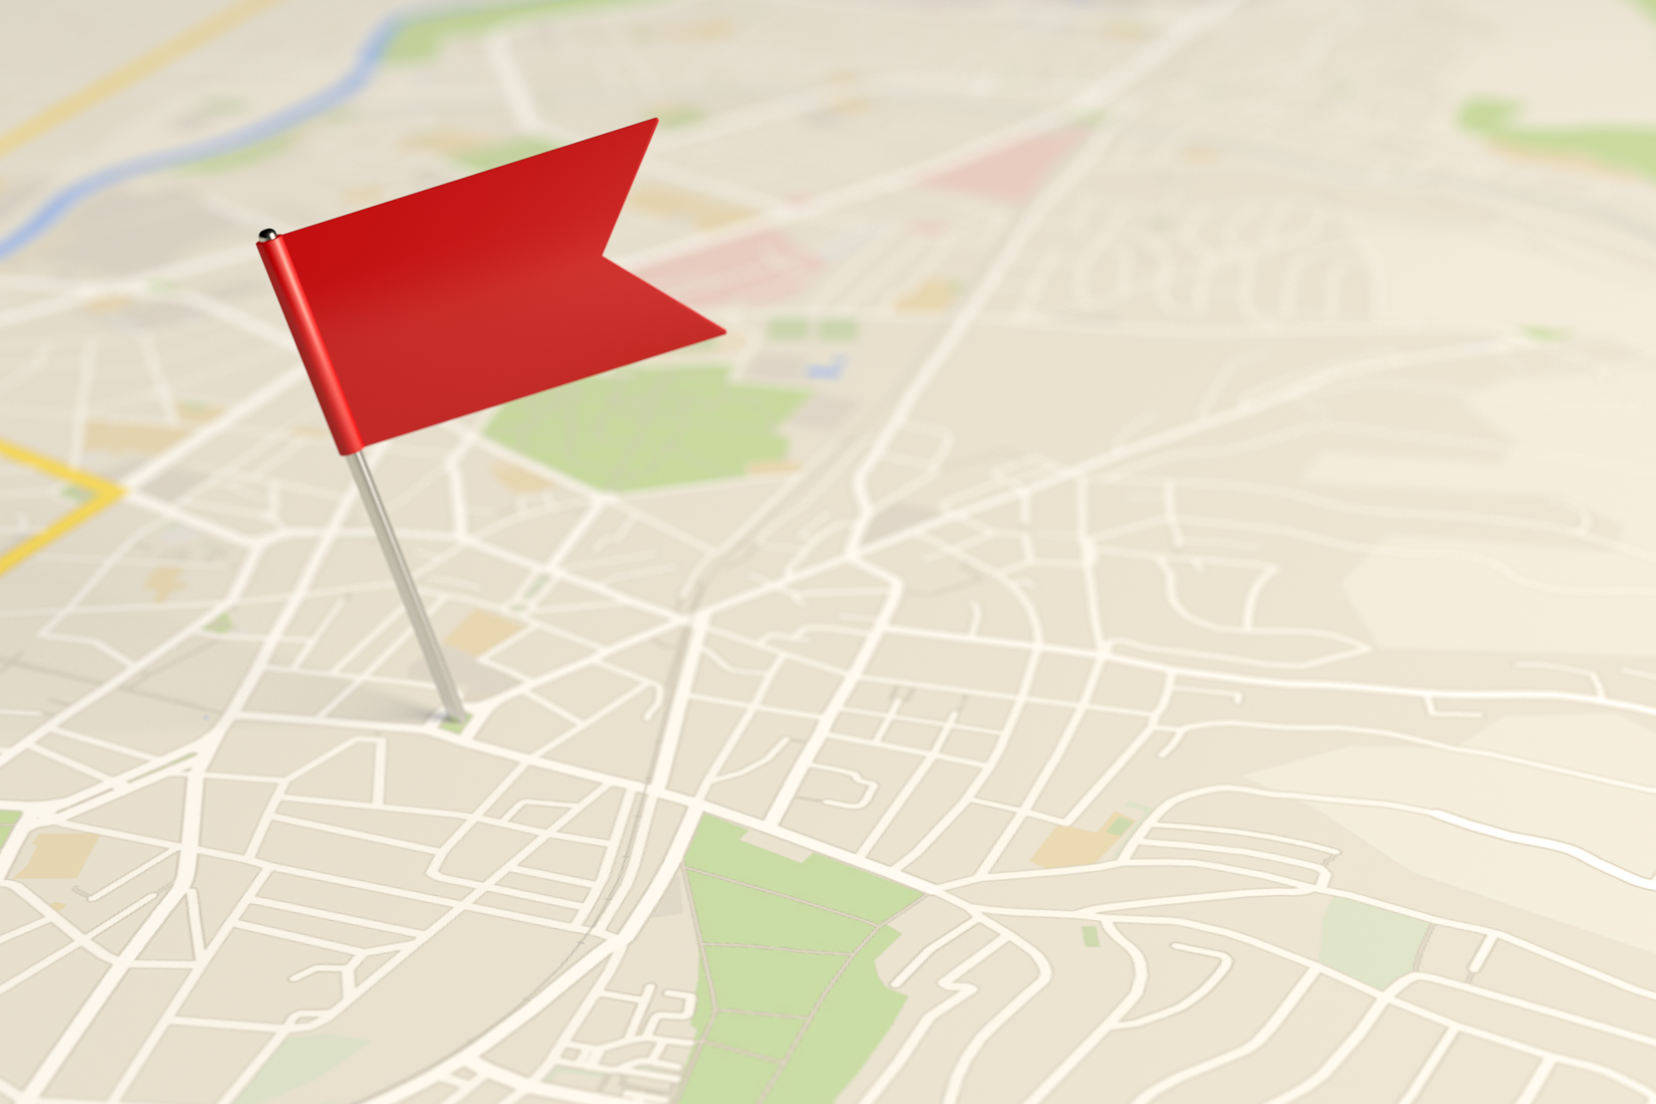
Before adding new site
Check Site List: Search for the site name and ID in the site list.
Check the Map: Check the map for the site and the nearby sites (some may have alternate names).
Add New Site: If no matching site exists, add the new site.
Handle Duplicates: If a duplicate is found, merge the sites.
Inactive Sites: If the site is inactive, update the profile to reflect “Closed” or “Evacuated.”
SMWG Review: All actions will be reviewed by the Site Management Working Group (SMWG).

Slide 7
Reviewing Site Details
Accuracy is Key: Ensure all information is correct; it's essential for assessments and analysis.
Before Assessments: Always review site details before submitting.
Demographic Data: Update through assessments or a demographic update submission.
Site Name (Arabic): Ensure it's filled accurately.
Status Update: If the site is closed or evacuated, update its status.
GPS Check: Verify GPS coordinates match the location.
Unknown Names: Change any instances of “Unknown” in the site name.
Do Not Change Site ID of existing site

Slide 8
Updating Site Demographic Data
Use Assessment Form:
Demographic data, such as the number of individuals and households, is updated using the assessment form.
You can submit demographic updates alone without completing a full assessment.
Displayed Data in Site Profile:
The site profile will display the most recent demographic data, showing the total number of individuals and households at the site.
Importance of Keeping Data Current:
Maintaining accurate and up-to-date demographic data is crucial, as other sectors rely on this information for planning and resource allocation.

Slide 9
Adding New Site
Add New Site (only if no match is found)
On the Site Manager homepage, select "Add New Site".
Assign Initial Site ID Format: First 3 letters of agency + 3-digit number (ACT123)
Site Name (English)
Region: Skip this field
Site Type: Agency Name
Site Status: Active, Closed, Evacuated (Do not use Unknown)
Location Type: Point
Last Updated: Date
Displacement Type
Site Name (Arabic)
Alternative Names (if applicable)
Approval SMWG will review and assign the final site ID.

Slide 10
Merging Sites
Identify Principal Site: Determine the main site to keep.
Create a Task:
Title: “Merge”
Type: “General”
Description: Include the principal site ID and IDs of secondary sites to merge.
Select Sites: Choose the principal and secondary sites from the list.
Assign Task: Assign to SMWG (Alisa and Uxue) and the reporting agency focal point.
Review and Merge: SMWG will review and merge the sites (no data will be lost).

